Slide 1

Airbnb price analysis
Ali Khatami
DSC530 - T301

Slide 2
Statistical Question/Hypothesis: 1. What factors affect the Airbnb rental prices in Europe? 2. How do Airbnb prices vary across cities in Europe? Which variables have the greatest impact on the price of a property?

Slide 3
Variables
Variables | Description
bedrooms | number of bedrooms
realSum | price of the rental houses
person_capacity | maximum number of guests
room_type | type of room
room_private | dummy for private rooms
room_shared | dummy for shared rooms
cleanliness_rating | guest reviews: scale to 10
guest_satisfaction_overall | guest reviews: scale to 100
host_is_superhost | dummy for hosts with the superhost status
multi | dummy for listings offered by hosts with 2–4 listings
biz | dummy for listings offered by hosts with more than 4 listings
dist | distance to the city centre in kilometres
metro_dist | distance to the closest metro station in kilometres
attr_index | attraction index: scale to 100
rest_index | restaurant index: scale to 100

Slide 4
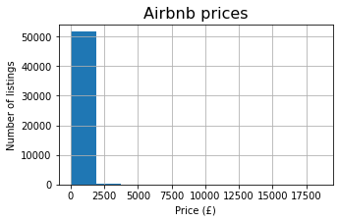
Histogram Analysis:
The Airbnb rental prices are mostly distributed under £2500, indicating that most of the data is concentrated on one end of the distribution. This type of distribution is commonly referred to as a "skewed right" distribution.
To make this visualization more comprehensive, we are going to look at the bins of the data to identify where we can cut the data. By doing this, we can create a more balanced histogram that accurately reflects the distribution of the data.

Slide 5
 | range | %
8 | (0, 50] | 0.096699
5 | (50, 100] | 5.883149
2 | (100, 150] | 19.589224
1 | (150, 200] | 20.521399
0 | (200, 350] | 32.889164
3 | (350, 500] | 10.990775
4 | (500, 1000] | 8.538496
6 | (1000, 1500] | 0.992129
7 | (1500, 2500] | 0.348115
10 | (2500, 3000] | 0.048349
11 | (3000, 3500] | 0.027076
9 | (3500, 18545] | 0.073491

